Slide 1


Concurrent Enrollment
Pleasant Hill High School 2025-2026

Slide 2

A Smart Start to college while in high school!
college course taught at high school by high school teacher
College course taught at the high school by jwcc instructor
college general education
career & technical course(s)
smart start career academies:
Welding
Truck Driver Training
Pre-Nursing
CNA
Transfer (Associate Degree)
General Education (GECC)
What is Concurrent Enrollment…
Notes:
Concurrent Enrollment allows eligible high school students the opportunity to earn both high school and college credit while still in high school. JWCC credits transfer to universities nationwide.
Complete an associate degree, college certficiate, or up to 60 hours of transfer credit before high school graduation!

Slide 3
Requirements to Participate
A 2.8 GPA or better OR a counselor or instructor recommendation.
Math courses specific: A 2.8 or > GPA AND Algebra II and Geometry with a C or >.
Accuplacer Testing if other requirements are not met.
A good attendance record is encouraged.
Motivation to do your best.
Some classes may have other prerequisites you will have to meet.
i.e., Intro to Psychology (PSY 101) is a requirement for Developmental Psychology (PSY 233)

Slide 4
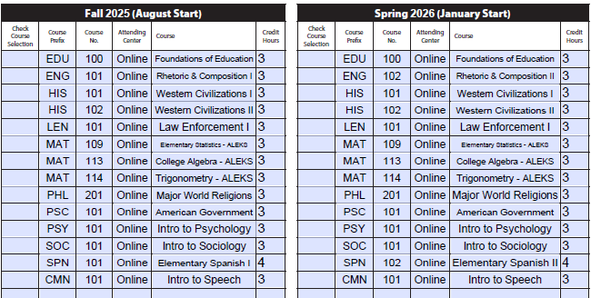
Pleasant Hill High School – Course Options
In CE classes, you are expected to be responsible like an adult college student, attend class, meet deadlines, and own your schedule.
Most popular courses:
English
Speech
Math
Psychology
Sociology
History
Humanities

Slide 5


Let’s Talk About Transferability!
Discuss the transfer of courses to your chosen institution with a JWCC advisor and see how credits from JWCC to other colleges at www.transferology.com.
Once coursework is completed, email JWCC advising to have an official copy of their transcript sent to the selected college or university.
Kristen Ritterbusch
Director of Pathways & Admissions
kritterbusch@jwcc.edu
217.641.4314

Slide 6

Transferring – What’s the Process? 6 Things to Know
Pick a major and transfer school as soon as possible. - This will ensure you and your advisor have time to research the requirements for your major/transfer school.
Visit the colleges/universities you are interested in attending. – This will give you an idea of the atmosphere of the campus and what will best fit your style of learning.
Keep in touch with your academic advisor at the community college level to let them know if you pick a major and transfer school, as well as any changes to your degree path. – This will allow your advisor to help you make any necessary changes to your classes or create you a different degree path for the remainder of your time at your community college.
Talk to transfer representatives from the college/university you plan to transfer to as early as possible to ensure your courses will transfer. – Reaching out to a transfer advisor from the college/university you plan to attend will be beneficial, as these are the experts of their schools' courses.
Research schools on the internet to get a feel for what you want in a college/university. – Looking at what the school offers in terms of degrees and fields of study, as well as resources and extra-curricular activities around campus, may help you decide sooner on a school to transfer to.
Always double-check your courses will transfer! – The receiving college/university always has final say as to which courses transfer into their institution. Community Colleges and Universities work together daily to make sure this is seamless. Ultimately, students need to reach out to their transfer institution to get something in writing stating that the courses will transfer from the community college.

Slide 7
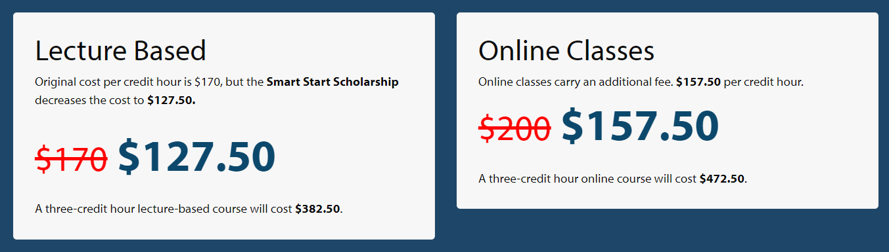

Cost for High School Students
Fall/Spring 2025-2026 Cost Update:
Course taught by qualified high school instructor at the high school = $50.00 per credit hour
Course taught at the high school by JWCC instructor = $100.00 per credit hour
Additional Cost: Lab Fees (if any) and books not already provided by high school.
Notes:
All high school students are awarded a 25% discount on tuition and universal fees.
Once a student graduates high school, they are eligible for financial aid through FAFSA.

Slide 8
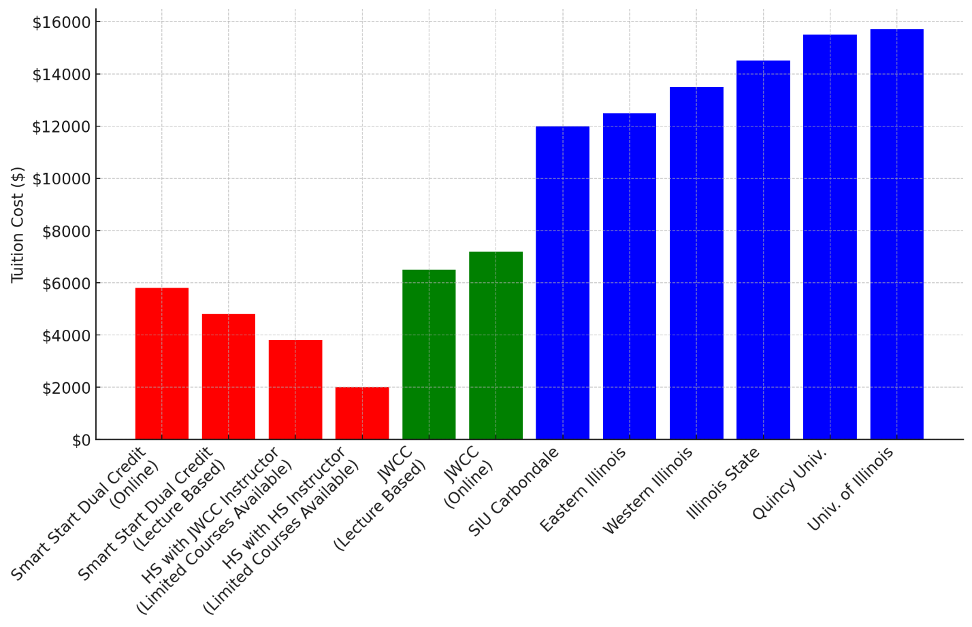
Compare Cost of 12 Courses per IL College
Cost After High School
SAVE with
Cost During High School
KEY: Tuition Cost Rates Only for 12 courses (37 Credit Hours)
*Totals do not include textbook or extra fees
*Estimated costs; Numbers found per institution website
The Benefits

Slide 9
Cost Savings:
Tuition discounted for high school students for college level classes.
Simultaneous Credit:
Earn credit for both high school and college or take college classes while in high school.
Educational Advantage
Get a jump start on your college career while easing the transition from high school to college.
Earn credit that can fulfill many university general studies requirements.
The Benefits

Slide 10
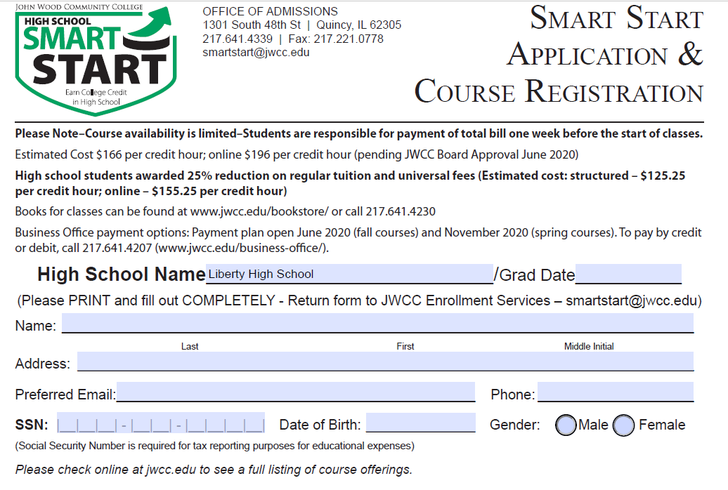
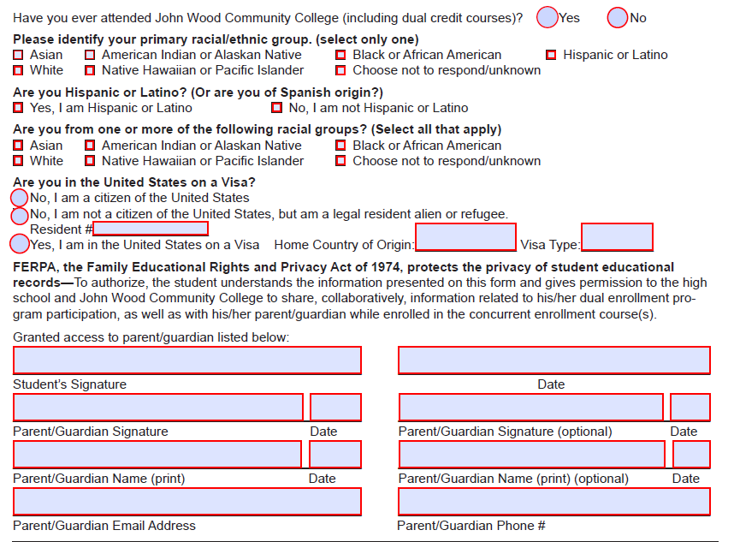
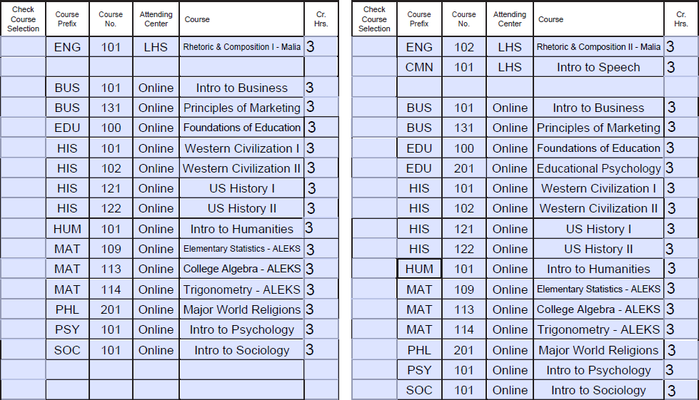
How to Register
Receive a copy of the registration form from counselor.
Once the registration form is completed, please submit to your counselor and she will submit to smartstart@jwcc.edu along with your high school transcript.
Once received, registration will be processed and the bill, schedule, and BlazerNet login information will be sent to home address/email.

Slide 11


Registration Begins
Spring 2026
October 7th
Summer 2026
March 4th

Slide 12

Registered: Next Steps
Log into BlazerNet (Login information sent via personal email)
Review Orientation found in Canvas.
Open your JWCC email account.
Review your schedule, and personal and billing information through SOLAR
Make payment arrangements for tuition- Bills sent out mid-December. (www.MyCollegePaymentPlan.com/JohnWood – Enroll via student’s SOLAR account)
Online Students – review your course content through Canvas – courses available on first day of class.
Math Student Only – Visit https://www.jwcc.edu/programs/online-learning/aleks/ for more information
Purchase books (if needed)
Spring 2026 classes begin January 20; Summer 2026 classes begin June 8.
NOTE: All cost not covered by the high school must be paid by due dates to avoid being dropped from courses
Notes:
#1. Work with your guidance counselor (Mr. Adams) to discuss your schedule next year.

Slide 13


Kelly Herzog Concurrent Enrollment Coordinator 217.641.4331
For more information, visit:
www.jwcc.edu/smartstart
Contact:
Email: smartstart@jwcc.edu

